Slide 1
Requirements Capture
Based on Chapter 6
Bennett, McRobb and Farmer
Object Oriented Systems Analysis and Design Using UML
4th Edition, McGraw Hill, 2010

Slide 2
In This Lecture You Will Learn:
The distinction between the current and required systems
When and how to apply the main fact finding techniques
The roles played by users
The need to document requirements

Slide 3
User Requirements
Need to understand how the organization operates at present
What are the problems with the current system?
What are the requirements users have of a new system that are not in the current system?

Slide 4
Current System
Much of the current system meets the needs of people who use it
Sections of the system no longer meet the needs of the organization
Some aspects of the organization’s work are not covered by the current system
The system can no longer evolve but needs to be replaced

Slide 5
Current System
It is important to understand the current system to carry functionality forward into the new system
It is also important to understand it so that shortcomings and defects can be corrected in the new system

Slide 6
Current System
Advocates of Agile methods focus on developing the new system and not on extensive analysis of the existing system
In the Agile Manifesto they state that they value working software over comprehensive documentation

Slide 7
Reasons for Investigating the Current System
Functionality is required in new system
Data must be migrated into new system
Technical documentation provides details of processing algorithms
Defects of existing system must be avoided
Parts of existing system may have to be kept
We need to understand the work of the users
Baseline information about the existing system helps set targets for the new one

Slide 8
New Requirements
Organizations operate in a rapidly changing business environment
Organizations operate in a changing technical environment
Governments and supra-governmental organizations introduce legislation
Organizations merge, demerge, take over and get taken over
All this drives the need to replace systems and build new ones

Slide 9
Types of Requirements
Functional
Non-functional
Usability

Slide 10
Functional Requirements
Describe what a system must do
Include:
  processes
  interfaces with users and other systems
  what the system must hold data about
Modelled with Use Case Diagrams. Later will be modelled with other kinds of diagrams that show the structure of the system (Class Diagrams) and its behaviour (Interaction Diagrams and State Machines)

Slide 11
Non-functional Requirements
Concerned with how well the system performs
Include:
  response times
  volumes of data
  security considerations
Documented in Requirements List or in Use Case Model (for requirements that can be linked to specific use cases)

Slide 12
Usability Requirements
Concerned with matching the system to the way that people work
Sets measurable objectives
Include:
  characteristics of users
  tasks users undertake
  situational factors
  acceptance criteria for the working system
Documented in Requirements List. May be tested by Prototypes

Slide 13
Fact Finding Techniques
Background Reading
Interviewing
Observation
Document Sampling
Questionnaires

Slide 14
Background Reading
Aim is to understand the organization and its business objectives
Includes:
  reports
  organization charts
  policy manuals
  job descriptions
  documentation of existing systems

Slide 15
Background Reading
Advantages:
  helps to understand the organization before meeting the people who work there
  helps to prepare for other types of fact finding
  documentation of existing system may help to identify requirements for functionality of new system

Slide 16
Background Reading
Disadvantages:
  written documents may be out of date or not match the way the organization really operates
Appropriate situations:
  analyst is not familiar with organization
  initial stages of fact finding

Slide 17
Interviewing
Aim is to get an in-depth understanding of the organization’s objectives, users’ requirements and people’s roles
Includes:
  managers to understand objectives
  staff to understand roles and information needs
  customers and the public as potential users

Slide 18
Interviewing
Advantages:
  personal contact allows the interviewer to respond adaptively to what is said
  it is possible to probe in greater depth
  if the interviewee has little or nothing to say, the interview can be terminated

Slide 19
Interviewing
Disadvantages:
  can be time-consuming and costly
  notes must be written up or tapes transcribed after the interview
  can be subject to bias
  if interviewees provide conflicting information this can be difficult to resolve later

Slide 20
Interviewing
Appropriate situations:
  most projects
  at the stage in fact finding when in-depth information is required
Requires skill to carry out effectively (See Box 6.1 for guidelines)

Slide 21
Observation
Aim is to see what really happens, not what people say happens
Includes:
  seeing how people carry out processes
  seeing what happens to documents
  obtaining quantitative data as baseline for improvements provided by new system
  following a process through end-to-end
Can be open-ended or based on a schedule

Slide 22
Observation
Advantages:
  first-hand experience of how the system operates
  high level of validity of the data can be achieved
  verifies information from other sources
  allows the collection of baseline data

Slide 23
Observation
Disadvantages:
  people don’t like being observed and may behave differently, distorting the findings
  requires training and skill
  logistical problems for the analyst with staff who work shifts or travel long distances
  ethical problems with personal data

Slide 24
Observation
Appropriate situations:
  when quantitative data is required
  to verify information from other sources
  when conflicting information from other sources needs to be resolved
  when a process needs to be understood from start to finish

Slide 25
Document Sampling
Aims to find out the information requirements that people have in the current system
Also aims to provide statistical data about volumes of transactions and patterns of activity
Includes:
  obtaining copies of empty and completed documents
  counting numbers of forms filled in and lines on the forms
  screenshots of existing computer systems

Slide 26
Document Sampling
Advantages:
  good for gathering quantitative data
  good for finding out about error rates
Disadvantages:
  not helpful if the system is going to change dramatically
Appropriate situations:
  always used to understand information needs
  where large volumes of data are processed
  where error rates are high

Slide 27
Questionnaires
Aims to obtain the views of a large number of people in a way that can be analysed statistically
Includes:
  postal, web-based and email questionnaires
  open-ended and closed questions
  gathering opinion as well as facts

Slide 28
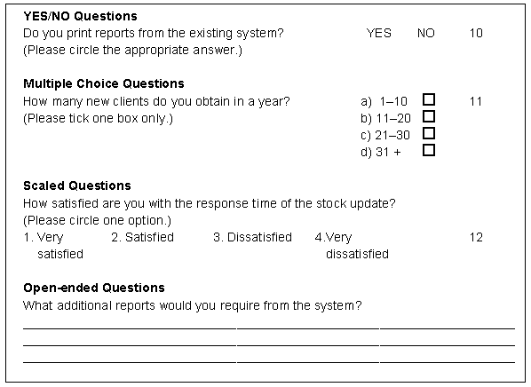
Notes:
Fig. 6.2

Slide 29
Questionnaires
Advantages:
  economical way of gathering information from a large number of people
  effective way of gathering information from people who are geographically dispersed
  a well designed questionnaire can be analysed by computer

Slide 30
Questionnaires
Disadvantages:
  good questionnaires are difficult to design
  no automatic way of following up or probing more deeply
  postal questionnaires suffer from low response rates

Slide 31
Questionnaires
Appropriate situations:
  when views of large numbers of people need to be obtained
  when staff of organization are geographically dispersed
  for systems that will be used by the general public and a profile of the users is required

Slide 32
Questionnaires
Require skill to design effectively (See Box 6.2 for guidelines)

Slide 33
User Involvement
A variety of stakeholders:
  senior management—with overall responsibility for the organization
  financial managers—who control budgets
  managers of user departments
  representatives of users of the system

Slide 34
User Involvement
Different roles:
  as subjects of interviews
  as representatives on project committees
  as evaluators of prototypes
  as testers
  as trainees on courses
  as end-users of new system

Slide 35
Documenting Requirements
Documentation should follow organizational standards
Modelling tools that produce UML models maintain associated data in a repository
Some documents will need separate storage in a filing system:
  interview notes
  copies of existing documents
  minutes of meetings
  details of requirements

Slide 36
Documenting Requirements
Documents should be kept in a document management system with version control
Use use cases to document functional requirements
Maintain a separate requirements list
Review requirements to exclude those that are not part of the current project

Slide 37
Requirements
Analyst
Project Initiation
Document
Elicit
requirements
Glossary
Candidate
Requirements
Select
requirements
Requirements
List
Develop
use cases
Use Case Model
Notes:
Fig. 6.3

Slide 38
Requirements
Team
Use Case Model
Requirements
List
Project Initiation
Document
Requirements
capture and modelling
Interface
Prototypes
Initial System
Architecture
Glossary
Notes:
Fig. 6.15

Slide 39
Summary
In this lecture you have learned about:
The distinction between the current and required systems
When and how to apply the main fact finding techniques
The roles played by users
The need to document requirements

Slide 40
References
Oppenheim (2000)
Allison et al. (1996)
Usability is covered in more detail in Chapter 16 of Bennett, McRobb and Farmer
Chapter A2 shows products of requirements capture and modelling
(For full bibliographic details, see Bennett, McRobb and Farmer)

